Slide 1

L-Scale
Application for tracking liquid levels

Slide 2
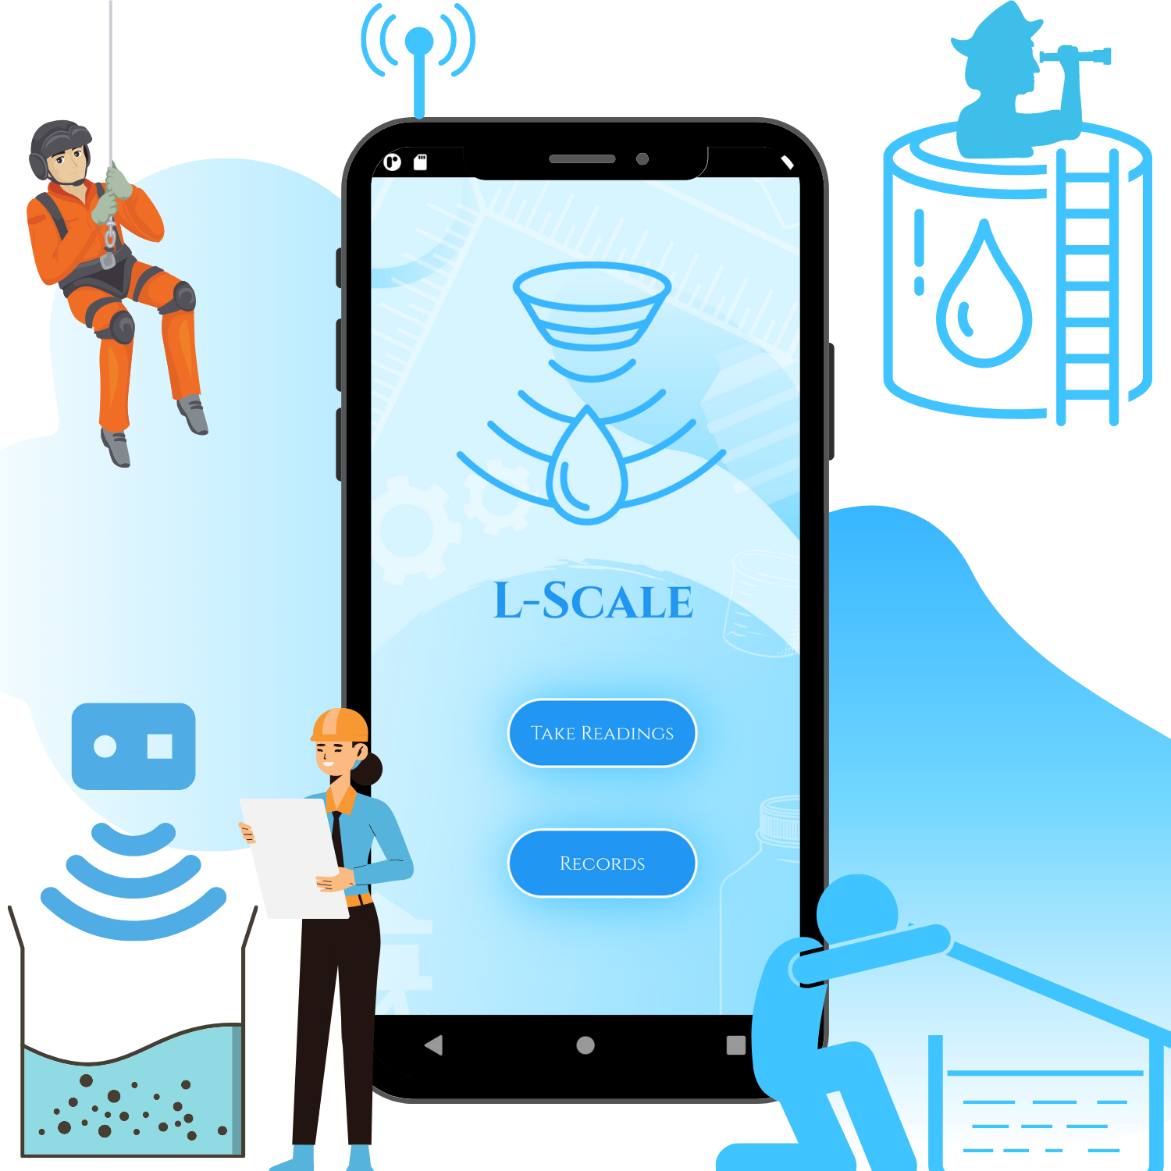
Developed by Team 220 volts
Kanav Bhasin (Email: kanavbhasin22@gmail.com)
Daksh Nauni (Email: mr.codefrost@gmail.com)
Yakshit Gupta (Email: guptayakshit@gmail.com)
Tanish Kamdar (Email: tanishkamdar@gmail.com)
PROBLEM: LACK OF LIQUID LEVEL TRACKING INSTRUMENTS
THEME: OPEN PLATFORM

Slide 3
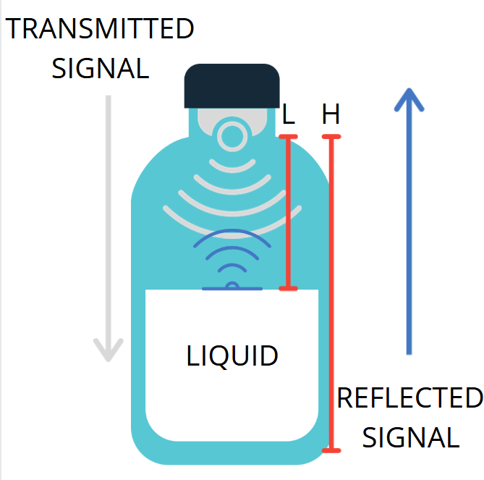
What is L-scale?
L-scale is a software-hardware project developed for Liquid level Tracking .

Slide 4
L-scale variants
fixed L-scale
mounted on a container/vessel/object
Sends data using api via internet to the app
portable L-scale
Can be mounted on a container/vessel/object
Can be removed from a container/vessel/object
Sends data using Bluetooth module to the app

Slide 5
How does it work?
L-scale consists of sensors like ultrasonic sensor which is used to measure the liquid levels in containers, wells, caves, etc.
On measuring the level, the liquid occupancy percentage is calculated.
This whole data is sent to thingspeak iot platform via nodemcu and from the cloud, this real time data is sent to a mobile application, where the concerned person can see the level.
Also, it sends alerts via app if the liquid goes down below a certain level.

Slide 6
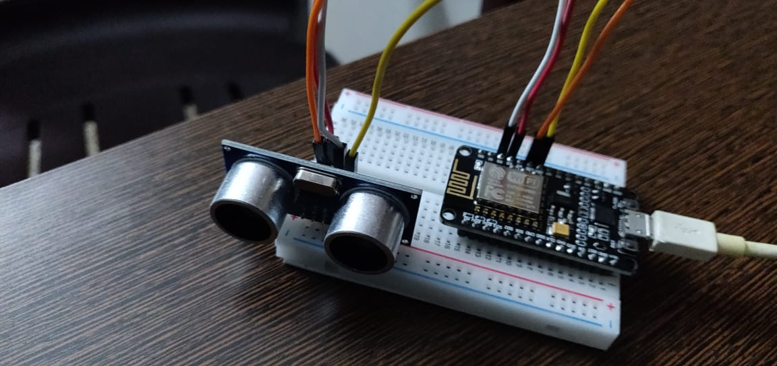
How does it works?
The Hardware: It consists of an ultrasonic sensor and a nodemcu. It is to be used as a lid for the container to be moitored

Slide 7





software
L-SCALE uses flutter as the end user application framework
Flutter allows the app to be cross platform
The app receives data using either bluetooth or fetch it from api depending upon the variant of the l-scale
Features of the app will be discussed in successive slides

Slide 8

How does it work?
Ultrasonic
Sensor
Arduino UNO
HC-05 Bluetooth Module/ ESP8266 (API)
Flutter App
ULTRASONIC LEVEL DETECTORS OPERATE BY GENERATING AN ULTRASONIC PULSE AND MEASURING THE TIME TAKEN FOR THE ECHO TO RETURN.
THE ADVANTAGE OF ULTRASONIC LEVEL DETECTOR INCLUDE ITS NON-CONTACT USE AND SUITABILITY FOR VARIOUS LIQUIDS.

Slide 9

Why l-scale?
The current Liquid Level monitoring systems are not Portable
Measurement of liquid level in process tanks for monitoring and/or controlling is essential in process industries.
Measuring liquid levels in places like wells and caves can be made easier
In process plants, tanks contain various liquids that are generally costly. Some of the liquids are inflammable and corrosive as well. Therefore, it is very much essential to monitor the level of liquid in a tank so that it doesn’t overflow from the tank
CAN PROVE TO BE A LIFE SAVOR IN RESCUE OPERATIONS
Cross Platform App to keep the track
Easy To Use User Interface

Slide 10

Motive Behind l-scale
MAKING PROFICIENT LIQUID LEVEL TRACKING POSSIBLE BY:-
USING ULTRASONIC SENSORS FOR ACCURATE MEASURES.
KEEPING A 24X7 CHECK ON LIQUID LEVELS.
EASY MONITORING WITH THE HELP OF TRACKING SOFTWARE AND USER FRIENDLY INTERFACE.
ITS NOT CONTACT USE AND SUITABILITY FOR VARIOUS LIQUIDS.
MULTI-UTILITY DEVICE.
CAN BE USED FOR EXPLORATION AND RESCUE OPERATIONS

Slide 11


Technology Stack
FLUTTER
THINGSSPEAK API
CLOUD
Arduino UNO
ESP8266 Wifi MCU
Internet of Things
Sensors

Slide 12
Applications Of l-scale
L-SCALE stands out the common because of its uniqueness, be it the design or portability or features
It is very accurate with the readings
It can be used to find water levels of wells or caves which no other device is currently capable of doing
It can prove to be a life savior when it comes to industrial use because it is capable of sending alerts to the user if the liquid levels drop below the set threshold mark

Slide 13

Current Features Of l-scale
Live Liquid Level Tracking
Automatic volume calculator
Cross Platform App ( Available on Android, iOS, Desktop & Web)
Beautiful User Interface
BLUETOOTH CONNECTIVITY
DEPTH MEASURES AND MONITORING
COMPLETE DATA STORAGE IN CLOUD

Slide 14
BUSINESS IDEA
L-SCAle as a business
TARGET AUDIENCE
BUDGET
Industrial Usage – Can be used in Water Treatment Plants, Chemical Plants etc.
Maintenance – Can be used in municipal services such as cleaning sewage
Exploration – Can be used in mines, caves and rescue operations etc.
Fixed L-Scale will be cheaper due to lack of Bluetooth module and stable mounting
Portable L-Scale will be an inexpensive option for Explorers, Field Engineers, Rescue Operators.
MARKETING
FEASABILITY AND USAGE
Many National/State/University Level programs have been launched in support of IOT projects as Atma Nirbhar Bharat currently. We plan to use this opportunity to get support from such programs.
L-Scale is a Multi-Utility IOT Device with support app, created to record and display user’s measurements. It is a low cost device that contributes directly to several utility and industrial purposes.

Slide 15
Photo Shoot

Slide 16




